Slide 1
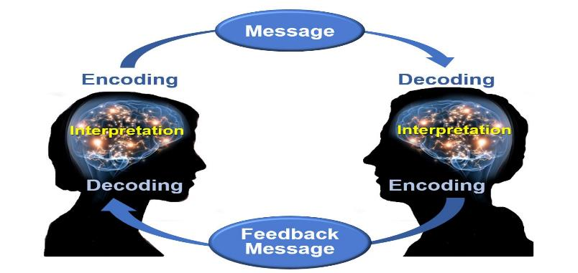
Negotiated Workplace Learning
Week 4
Sandra Okwara

Slide 2

Communication Skills
Basics of Workplace Communication
Planning communication in the workplace
Effective Written Communication
Effective Face to Face Communication
This Photo by Unknown Author is licensed under CC BY

Slide 3
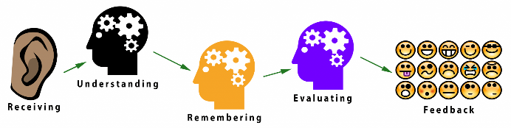
Basics of Workplace Communication
Different Channels are available for communication in the workplace. A systematic approach is required to ensure workplace communication is effective.
It is important to understand the communication cycle

Slide 4
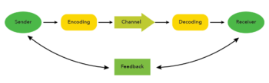
Communication Cycle
Workplace communication is required to be made in a clear, concise and easy manner to aid better understanding.
Do you Struggle to plan your message?
Do you need to know?
The Communication Cycle is a six-step process which can be helpful in tailoring and refining your messages. Developed by Charles Berner, the model was updated into its modern form by Oxford professor Michael Argyle in his 1972 book, The Social Psychology of Work.
REFERENCES
Argyle M. (1972). 'The Social Psychology of Work,' London: (Allen Lane)

Slide 5
Benefits of Communication Cycle .
Helps to ensure nothing essential is forgotten when you present your communication
Maximises the impact of your communication
Encourages individuals to make use of feedback received to improve future communications

Slide 6
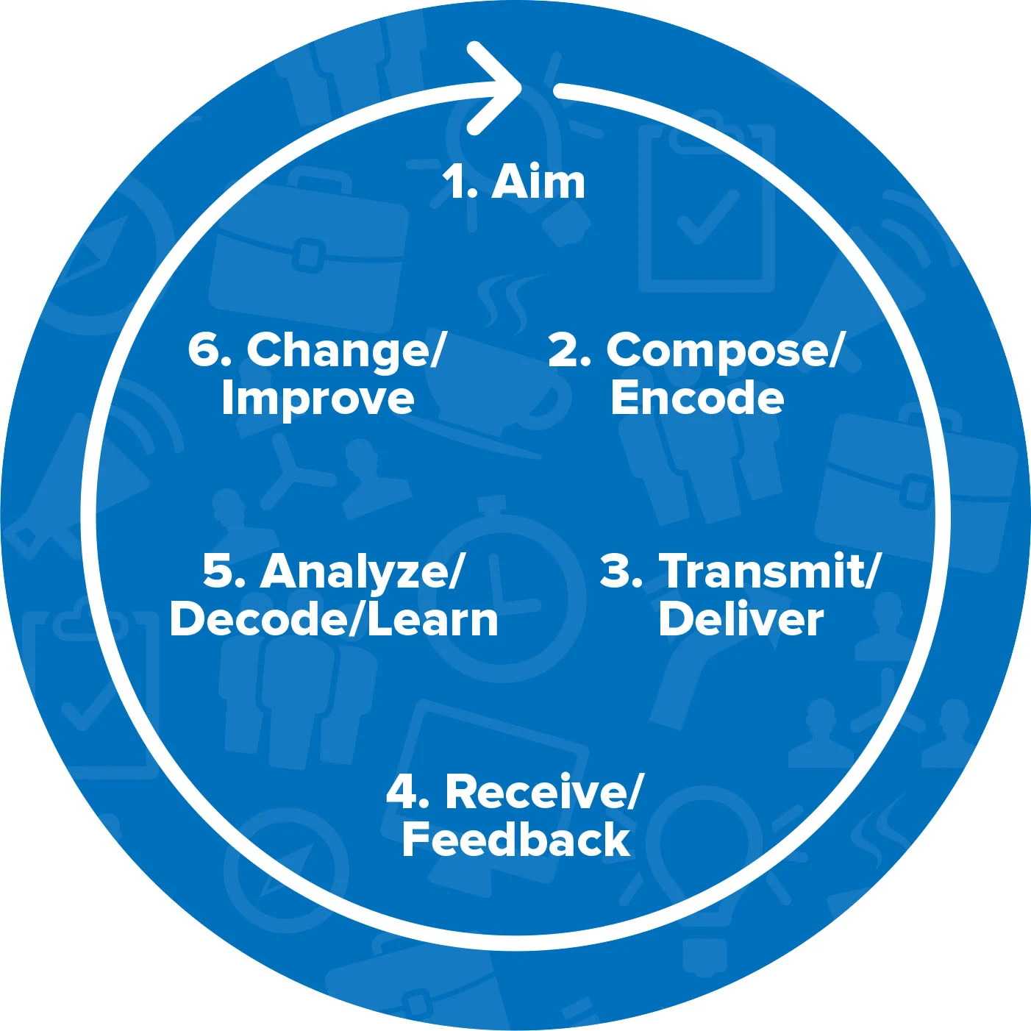
Communication Cycle

Slide 7
Using the Communication cycle
Step One: Clarify Your Aim
Use the questions below to organise your thoughts about the message/information you want to share
Who do I need to communicate with?
What message am I trying to send?
What am I trying to achieve?
Why do I want to send this message?
Do I need to send the message at all?
What do I want my audience to feel?
What does my audience need or desire from the message I am passing ?
What do I want my audience to do with this information?

Slide 8

Step Two: Compose your message
What is the best way to communicate this message?
What level/type of language should I use?
Does the audience have any background information on the topic?
Will my audience need any additional resources to understand my message?
Am I expressing emotions in my message? If so, which emotions?
Will the audience assume anything about me or my motives that will damage the credibility of the communication?

Slide 9
Step Three: Transmit/Deliver
What is the right time to send the message?
What will the state of mind of the audience be when they receive the message?
How will the message be delivered taking account of the audience state of mind
Consider distractions that may affect the delivery and receiving of the information
Identify who needs to be included in the message

Slide 10
Step Four: Receive Feedback
This is a crucial step in communication as if feedback is not received from the audience, the individual may never know how to improve the way to communicate information
Understand the body language of the individuals receiving the message
Allow time for questions to be asked by the audience
Ask for feedback ( indirect feedback can be used)

Slide 11
Step Five: Analyze/Decode/Learn
Use the feedback provided to develop
Message may need to be written or sent again based on the feedback received.
Consider what the feedback is about the communication
Reflect on what could have been done differently to get a better response
Check if the expectation of the audience was met
What could be done differently for the future

Slide 12
Step Six: Change/Improve
For communication to be effective, there needs to be commitment to learning and development
Respect the feedback .
Change your message or behaviour as required
Identify the resources that can support improvement

Slide 13
Planning your communication 7Cs to Communication
Communication in the workplace needs to be
Clear : Be clear about your message
Concise: Stick to the point and keep it brief
Concrete: Give the audience a focused picture of your message
Correct :Ensure your message is correct
Coherent: Ensure your message is logical and points connect to each other
Complete: provide the audience with everything they need to be informed and, if applicable, take action.
Courteous: Be friendly, open and honest in your communication

Slide 14
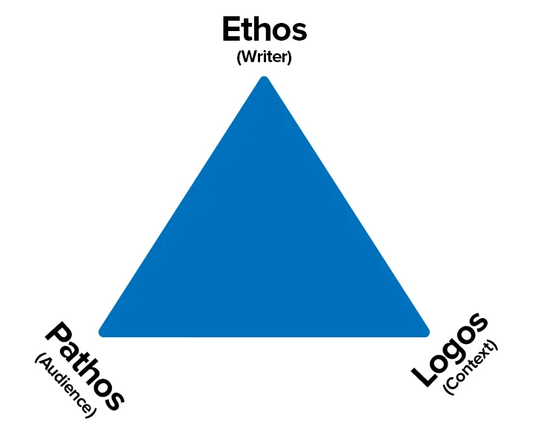
Rhetoric Triangle
Ethos: Build trust by establishing your credibility and authority (Writer)
Pathos: Connecting to your audience interest and values by appealing to your emotion (Audience).
Logos: Using well constructed and clearly argued ideas to appeal to your audience's intelligence (Context).

Slide 15
Ethos (Writer)
This is the way in which the argument is affected by the Speaker/writer (Ethos)
First clarify who you are from the beginning
Audience may feel you are hiding something if they don’t understand who you are and why you are passing the in formation
The audience will try to understand your motives , beliefs, values and your assumptions to help them to evaluate your credibility and sincerity

Slide 16
Pathos (Audience)
In workplace communication, individuals need to understand the audience they are communicating with and appeal to their emotions
Be clear with what you are communicating with the audience
Communication style needs to be planned
Understand your audience and avoid the use of jargons
Pay attention to your emotions

Slide 17
Logos (Context)
Use relevant argument
Provide evidence for your claims
Be logical

Slide 18
Using the Rhetorical Triangle
Establish Your Credibility (Ethos)
Ensure you reveal your biases, values and belief to the audience
Explain your expertise
Make use of appropriate testimony from experts
Consider why you are communicating with the audience . Is it : A call for action? To give information? Persuade them to change? Give ideas? Entertain them ?

Slide 19
Appeal to the Audience's Emotions (Pathos)
There is a need to understand the audience
Connect with your audience
Understand the expectations of the audience
Understand why they are reading / or listening to you
Ensure you know what you expect from the discussion
What type of emotion do you want to evoke?

Slide 20
Consider the Context (Logos)
Consider the best way to deliver your message
Identify the best way to pass the message (Presentation, email, phone, face to face, letter etc)
Consider if you need to use a formal or informal tone to deliver the message
Give as much background information as needed
Deal with counter arguments as needed.

Slide 21

Key Points to remember
The Communication Cycle is a six-step process for organizing and presenting a message effectively. You can apply it in all situations that involve communication, but it's most useful for important or complex communications.
The process follows a cycle that includes these six steps:
Clarify your aim.
Compose/Encode.
Transmit/Deliver.
Receive feedback.
Analyze/Decode/Learn.
Change/Improve.

Slide 22


What have you Learnt?

